Slide 1





CPC PERFORMANCE
MAR’25 & APR’25

Slide 2

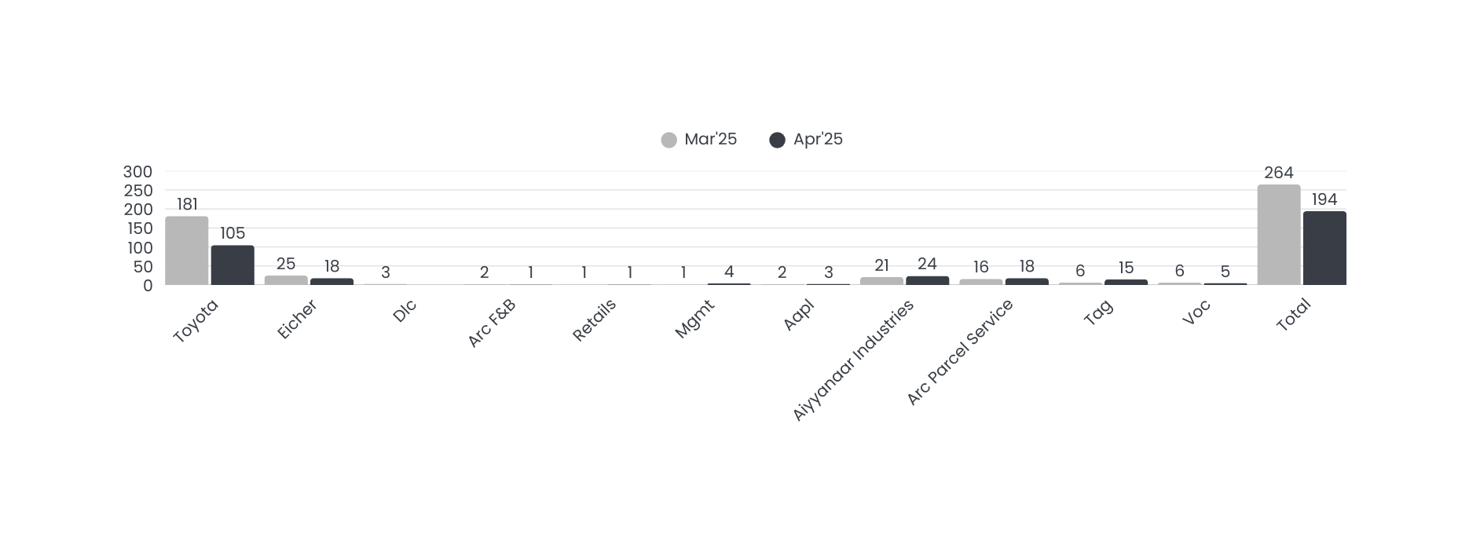
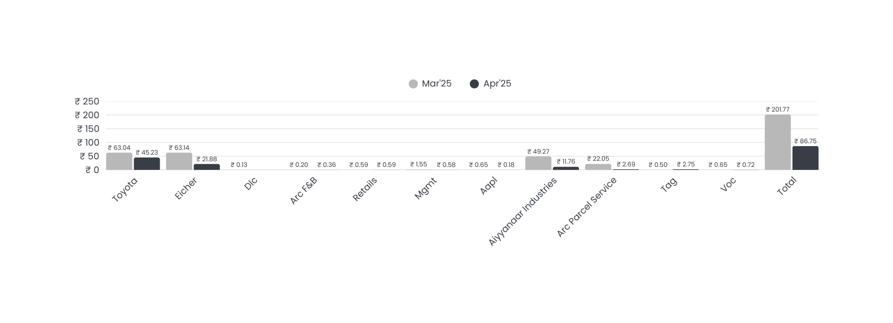
SBU Wise Performance
PO Numbers
PO Value

Slide 3
Item Category Wise Purchase
Item Desc | Mar’25 | Mar’25 | Apr’25 | Apr’25 | Total PO's | Total Po Value
Item Desc | PO No's | PO Value | PO No's | PO Value | Total PO's | Total Po Value
Civil Work | 14 | 9113404 | 6 | 2823608 | 20 | 11937012
General | 24 | 3213863 | 18 | 1630544 | 42 | 4844407
Tools & Equipments | 68 | 2635872 | 34 | 1138379 | 102 | 3774251
ITS/Electronics | 21 | 1134072 | 31 | 1026583 | 52 | 2160655
Electrical Items / Service | 16 | 1016340 | 14 | 741684 | 30 | 1758024
AC New / Service | 6 | 745265 | 4 | 102346 | 10 | 847611
Printing | 31 | 493099 | 17 | 217715 | 48 | 710814
Stationery | 27 | 344106 | 17 | 113056 | 44 | 457162

Slide 4
Continue
Item Desc | Mar’25 | Mar’25 | Apr’25 | Apr’25 | Total PO's | Total Po Value
Item Desc | PO No's | PO Value | PO No's | PO Value | Total PO's | Total Po Value
Furniture & Fixtures | 4 | 208624 | 6 | 204308 | 10 | 412932
Promotional Activity | 12 | 281661 | 4 | 62755 | 16 | 344416
Welfare | 5 | 55358 | 9 | 260023 | 14 | 315381
Mechanical | 4 | 250007 | 3 | 39192 | 7 | 289199
Periodical | 3 | 251159 | 2 | 9661 | 5 | 260820
Signage | 2 | 141299 |  |  | 2 | 141299
Saftey Items | 14 | 87168 | 10 | 45564 | 24 | 132732
AMC Renewal | 1 | 58528 | 2 | 72034 | 3 | 130562

Slide 5
Continue
House Keeping | 7 | 40763 | 6 | 44402 | 13 | 85165
Transportation | 1 | 54750 |  |  | 1 | 54750
Canteen Items | 1 | 1380 | 5 | 52344 | 6 | 53724
Plumbing materials | 2 | 31269 | 1 | 7455 | 3 | 38724
Fire and Safety Items |  |  | 1 | 37524 | 1 | 37524
Trail Room Interior | 1 | 29910 |  |  | 1 | 29910
Calibration Certificate | 1 | 14455 | 1 | 10100 | 2 | 24555
RO Plant |  |  | 1 | 20000 | 1 | 20000
Software Renewal |  |  | 2 | 15289 | 2 | 15289
Grand Total | 265 | 20202352 | 194 | 8674566 | 459 | 28876918

Slide 6

Support Required
S NO | Support
1
2
3
4
5
6

Slide 7


